Slide 1




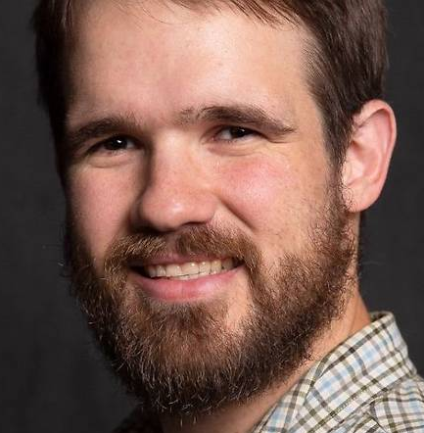
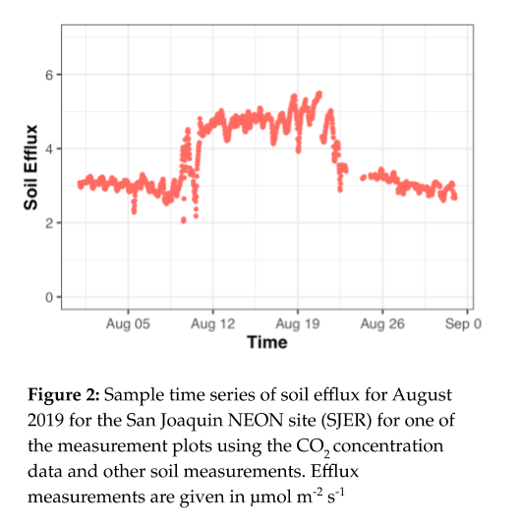
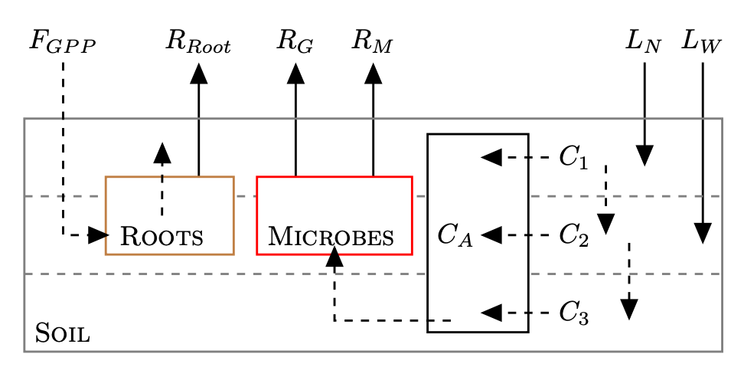

Collaborative Research: MSA: RUI: Development and validation of a continuous soil respiration product at core terrestrial NEON sites NSF# 2017829
“The Z Team”
← John M. Zobitz, Department of Mathematics, Statistics, & Computer Science, Augsburg University, Minneapolis, MN
Zobitz@Augsburg.edu @ProfZobitz
Naupaka Zimmerman, Department of Biology, University of San Francisco, San Francisco, CA → nzimmerman@ufsca.edu @naupakaz
We will develop and validate models for soil CO₂ flux from NEON sites.
We will lead PUI faculty in a mentoring cohort to build research capacity and teaching materials.
Overview
Develop & validate a continuous soil CO₂ efflux product at Core Terrestrial sites.
Corroborate soil CO₂ effluxes and parameterize biogeochemical models.
Increase the participation of PUI faculty and students engaging with NEON data and macrosystems science.
Increase faculty capacity for conducting culturally sustaining research training of undergraduates
What
Deploy temporary instrumentation at NEON sites to validate fluxes, along with an R package documenting methods.
Benchmark fluxes against the Soil Respiration Database w/ data assimilation
Support instrumentation grants for PUI faculty in exchange for developing curriculum modules.
Conduct professional development in intercultural development theory and practice.
How

